Slide 1
Greenmate
Christopher Huynh
Chen-Yu Chang
Yiqin Zhang
Hanming Wang
Michael Harkess
Samarah Uriarte

Slide 2
Team – Green Dolphin
Christopher Huynh --- Project Lead
Chen-Yu Chang --- Specification Lead
Yiqin Zhang --- Interface Lead
Hanming Wang --- Technical Lead
Michael Harkess --- Technical Lead
Samarah Uriarte --- Documentation Lead

Slide 3
App Purpose
To encourage people to be more eco-friendly, we created this app recording the walking steps, the distance traveled by bicycle, and the recycling history. Those actions will reward the users to gain some energy, while this energy can be used to exchange rewards, such as coupons or products if we are able to work further with companies.

Slide 4
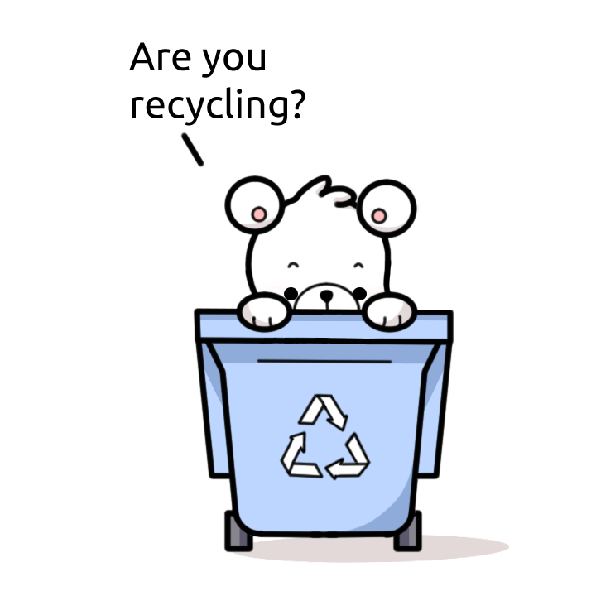


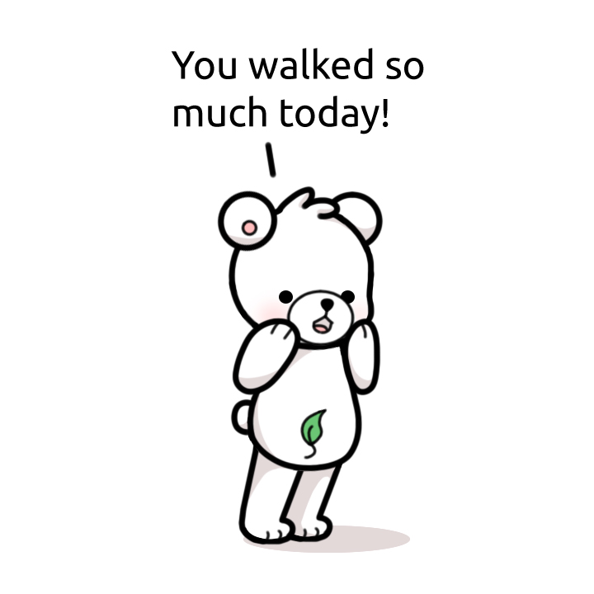
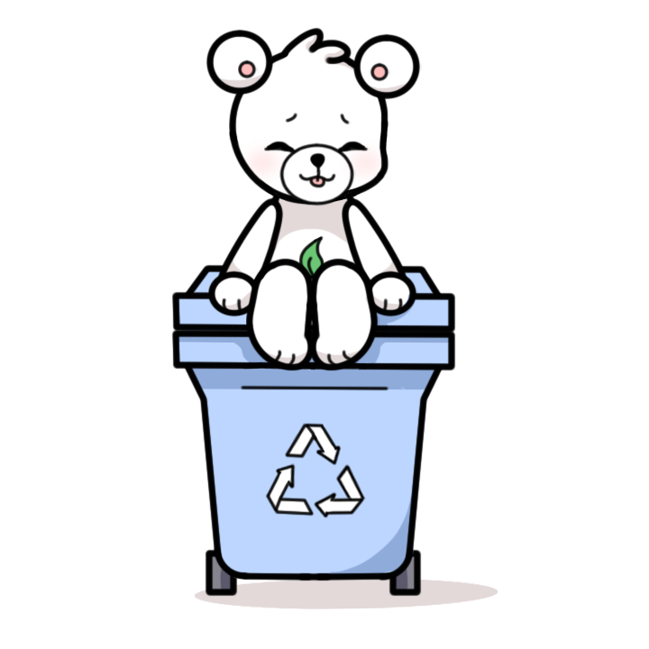


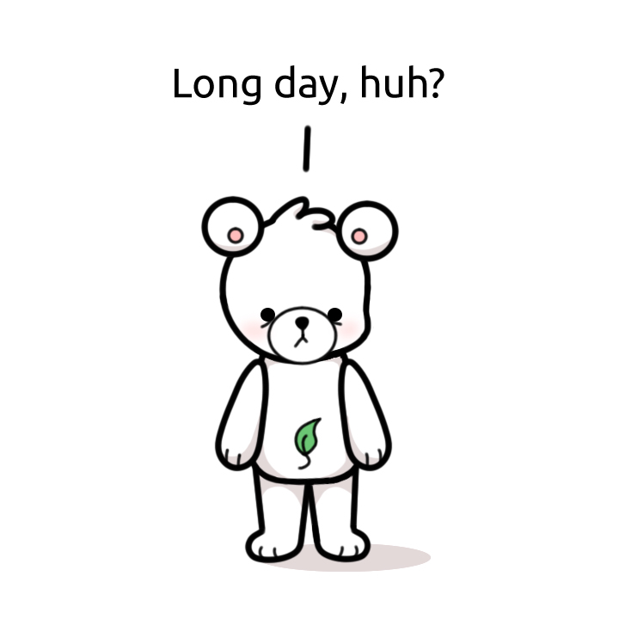

Main Character-Bear
The bear that Samarah drew will change in different stages when sensing user’s situation.

Slide 5
Software Architecture
Home Activity
Sensor Filter
Step Listener
Step Detector
Step Calculation
Login Activity
GPS
Maps Activity
Point System
Recycle Rules
UI Design

Slide 6
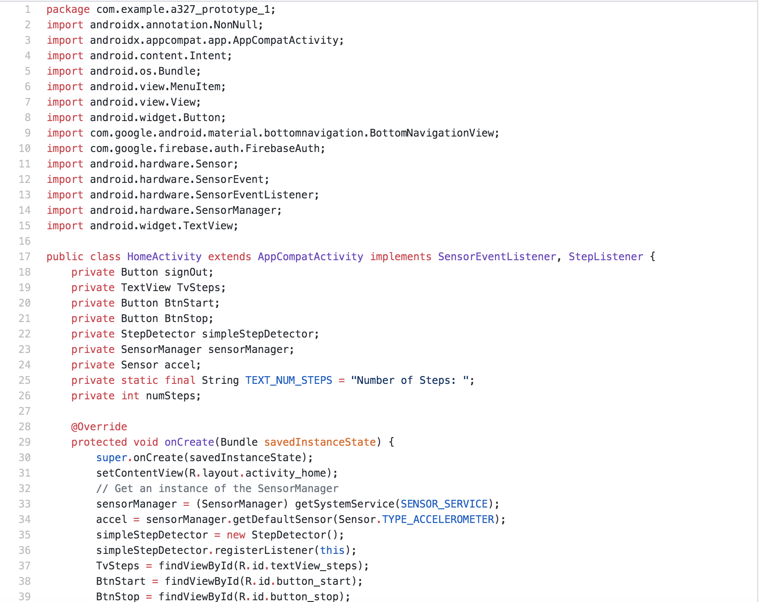
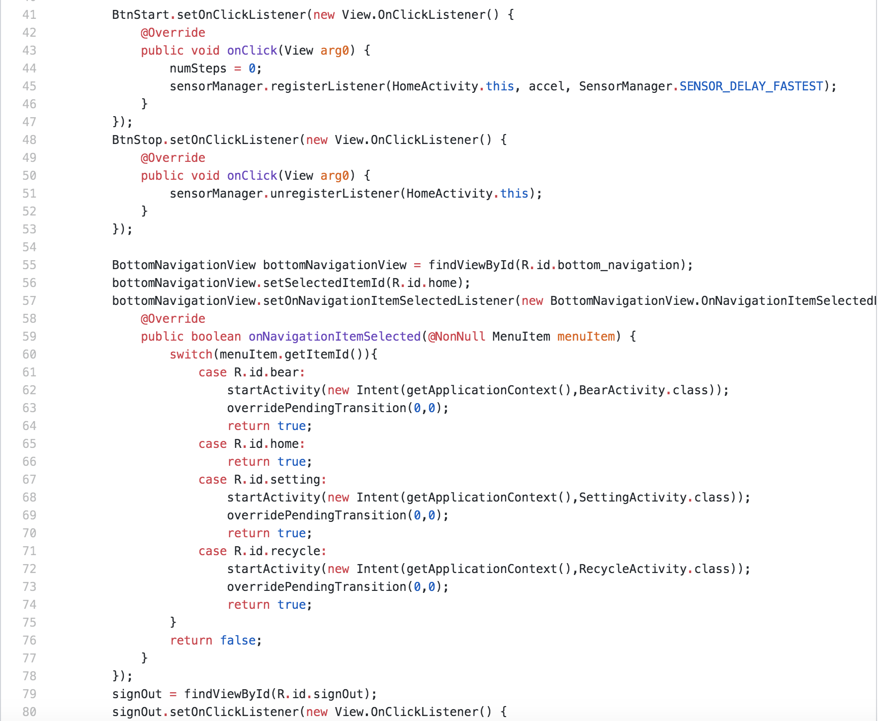
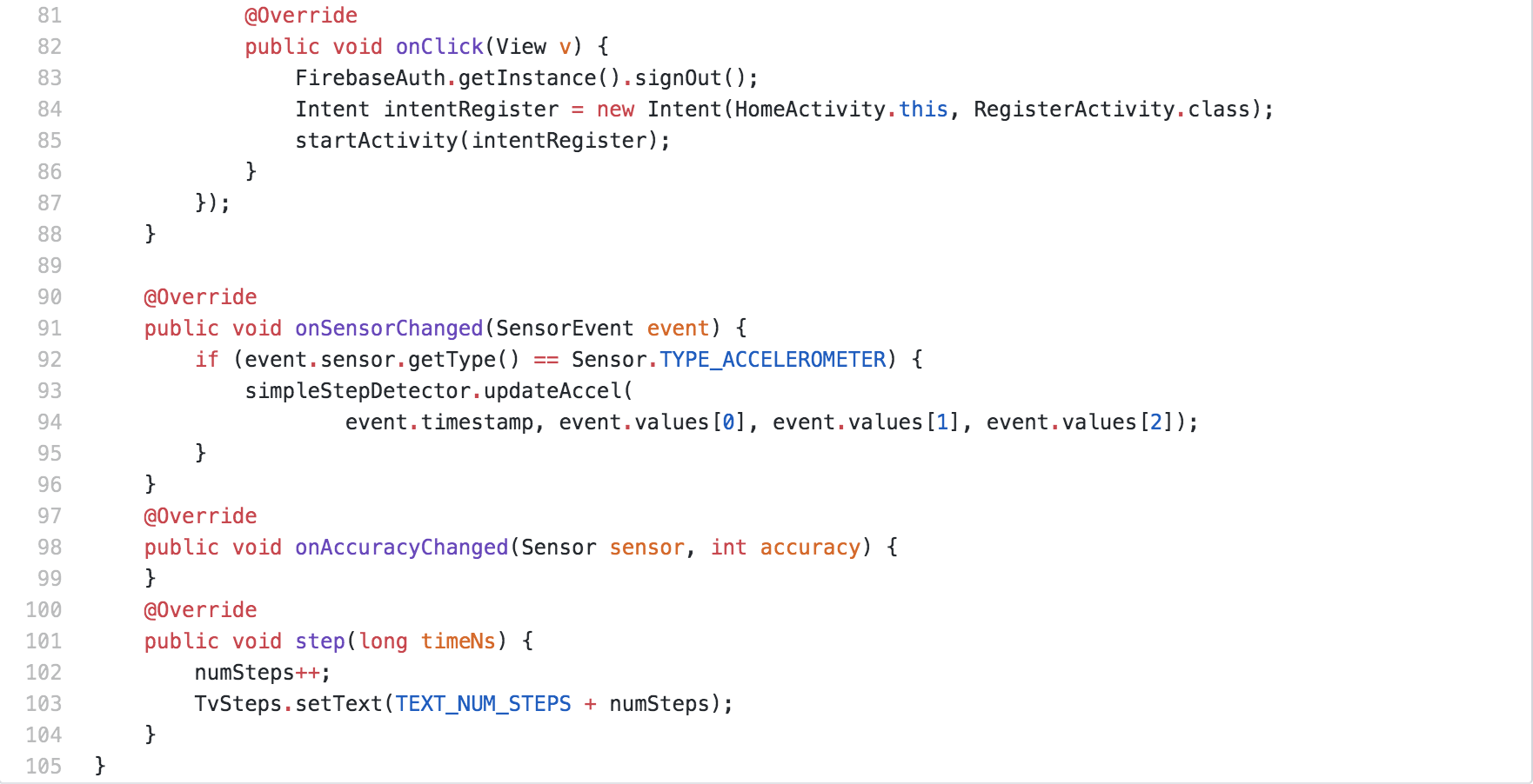
Home Activity
This function combine several functions for accelerometer sensor we use inside the phone. It is the core of counting steps with branches, such as Step Detector, Step Listener, Sensor Filter, and Step Calculation. It will start recording the readings and show the results to the user.

Slide 7
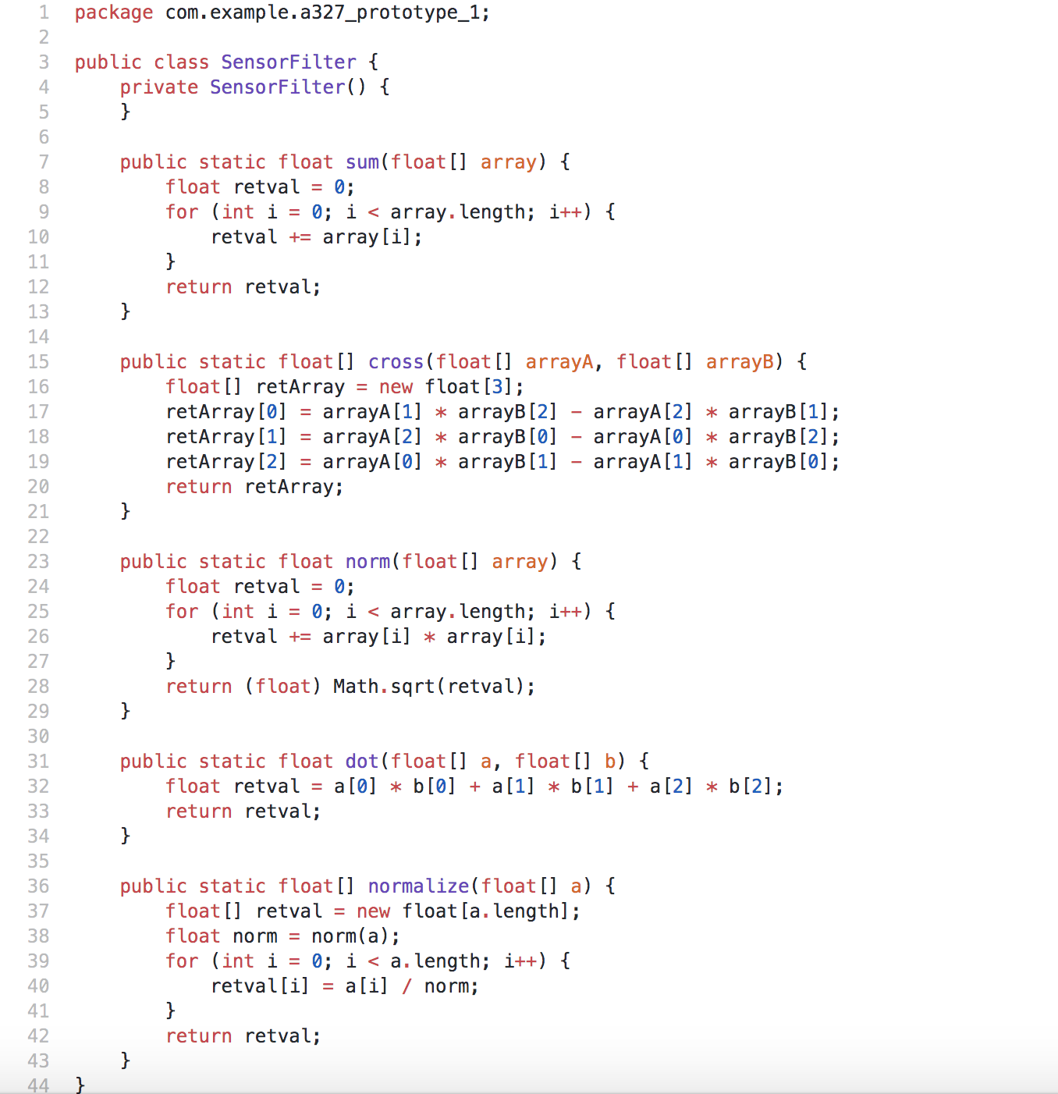
Sensor Filter
This is a class that operates an algorithm to filter out the values that has an approximation of steps by the sensor installed in the phone. This is also a subsystem used in the Home Activity.

Slide 8
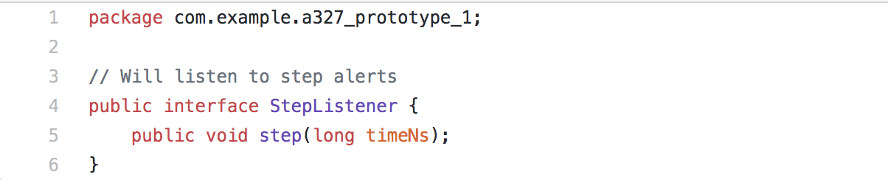
Step Listener
This interface will listen to alerts about steps being detected. This is a subsystem used in the Home Activity.

Slide 9
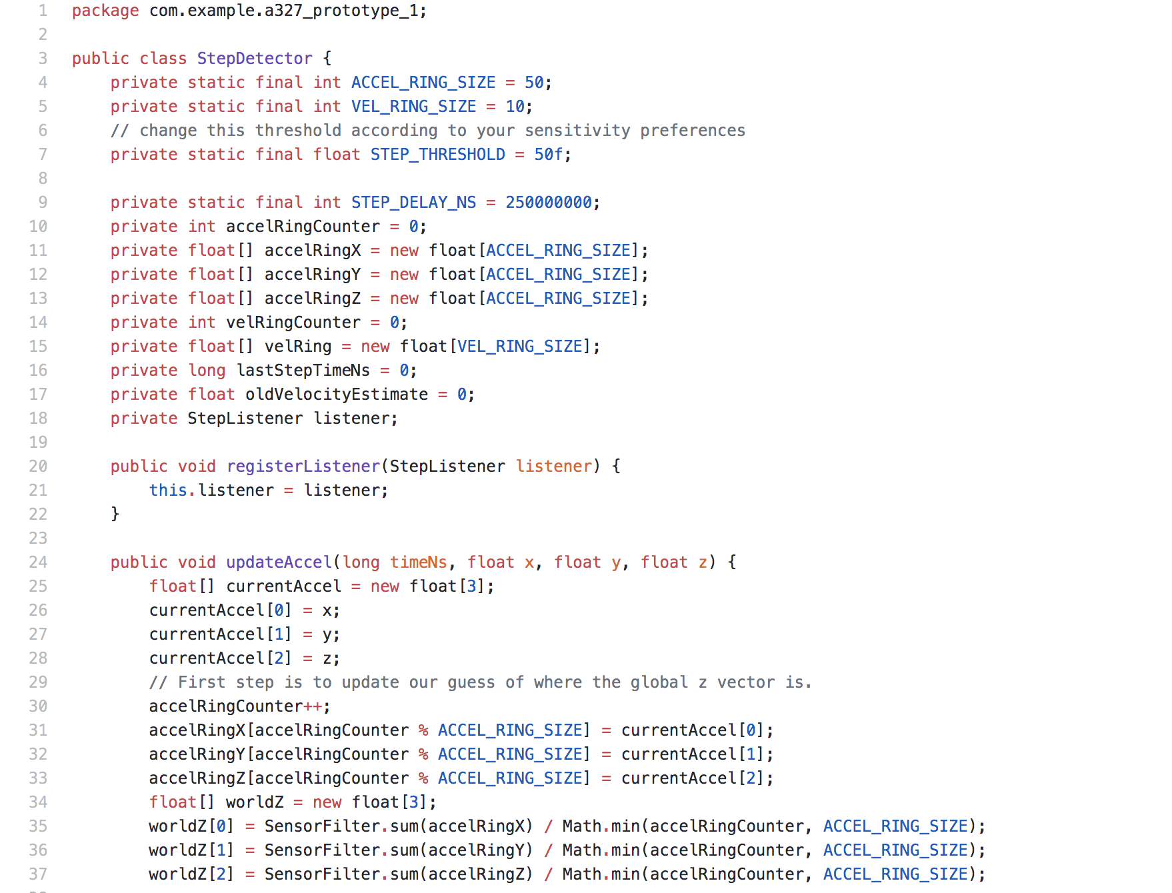
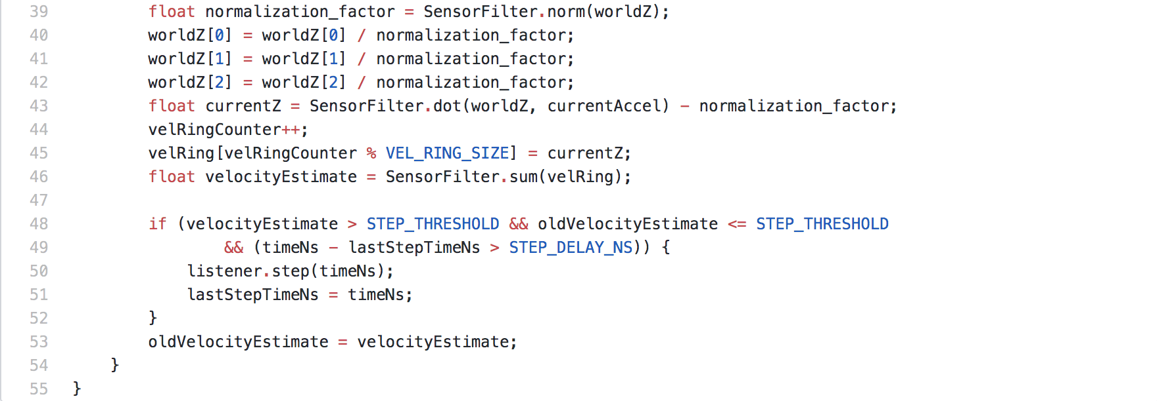
Step Detector
This function creates a class that accepts the updated data from accelerometer sensor and deploys the filter to detect if a step was covered by the user. It is operated inside the Home Activity after the user pressed start to start detecting.

Slide 10
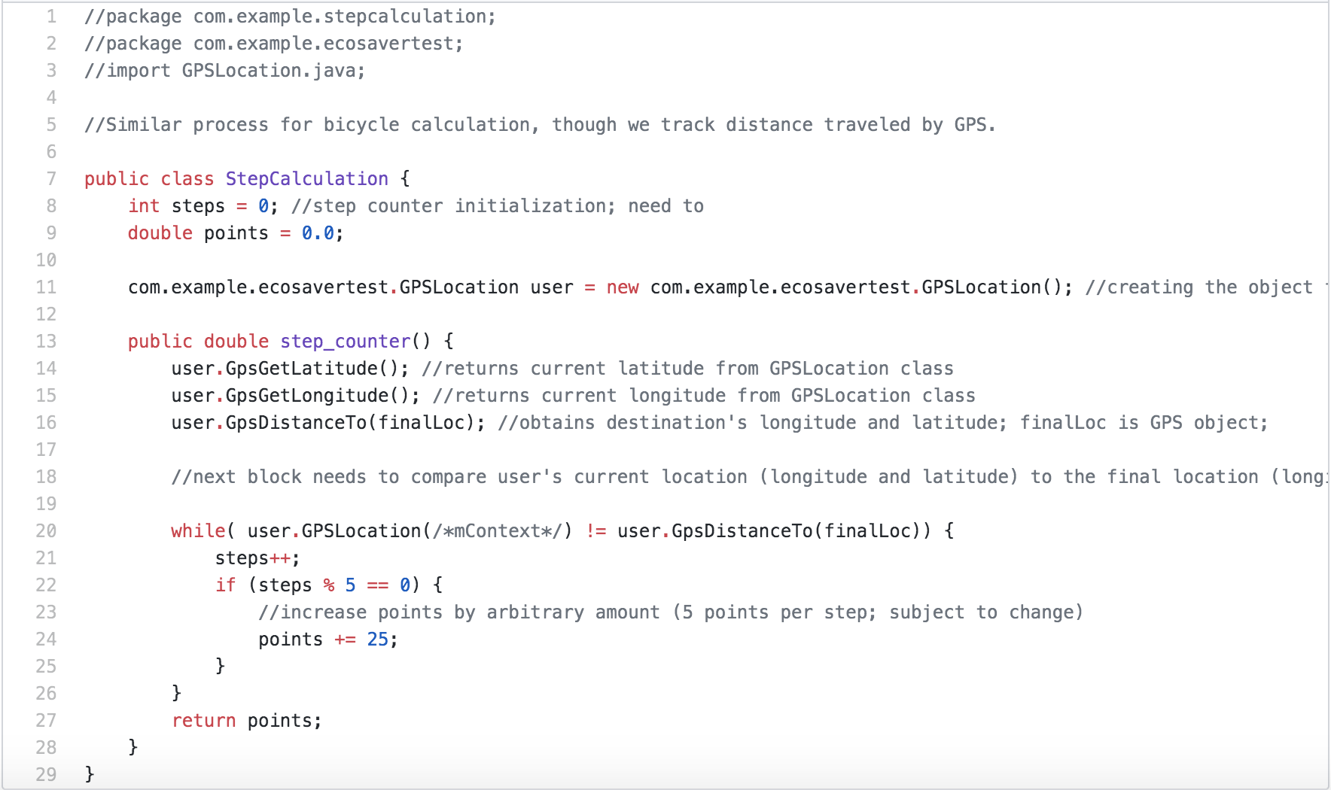
Step Calculation
This function converts the steps recorded into points since the whole app rewards the user by the number of points. Therefore, we designed a system to calculate the conversion between steps and points.

Slide 11
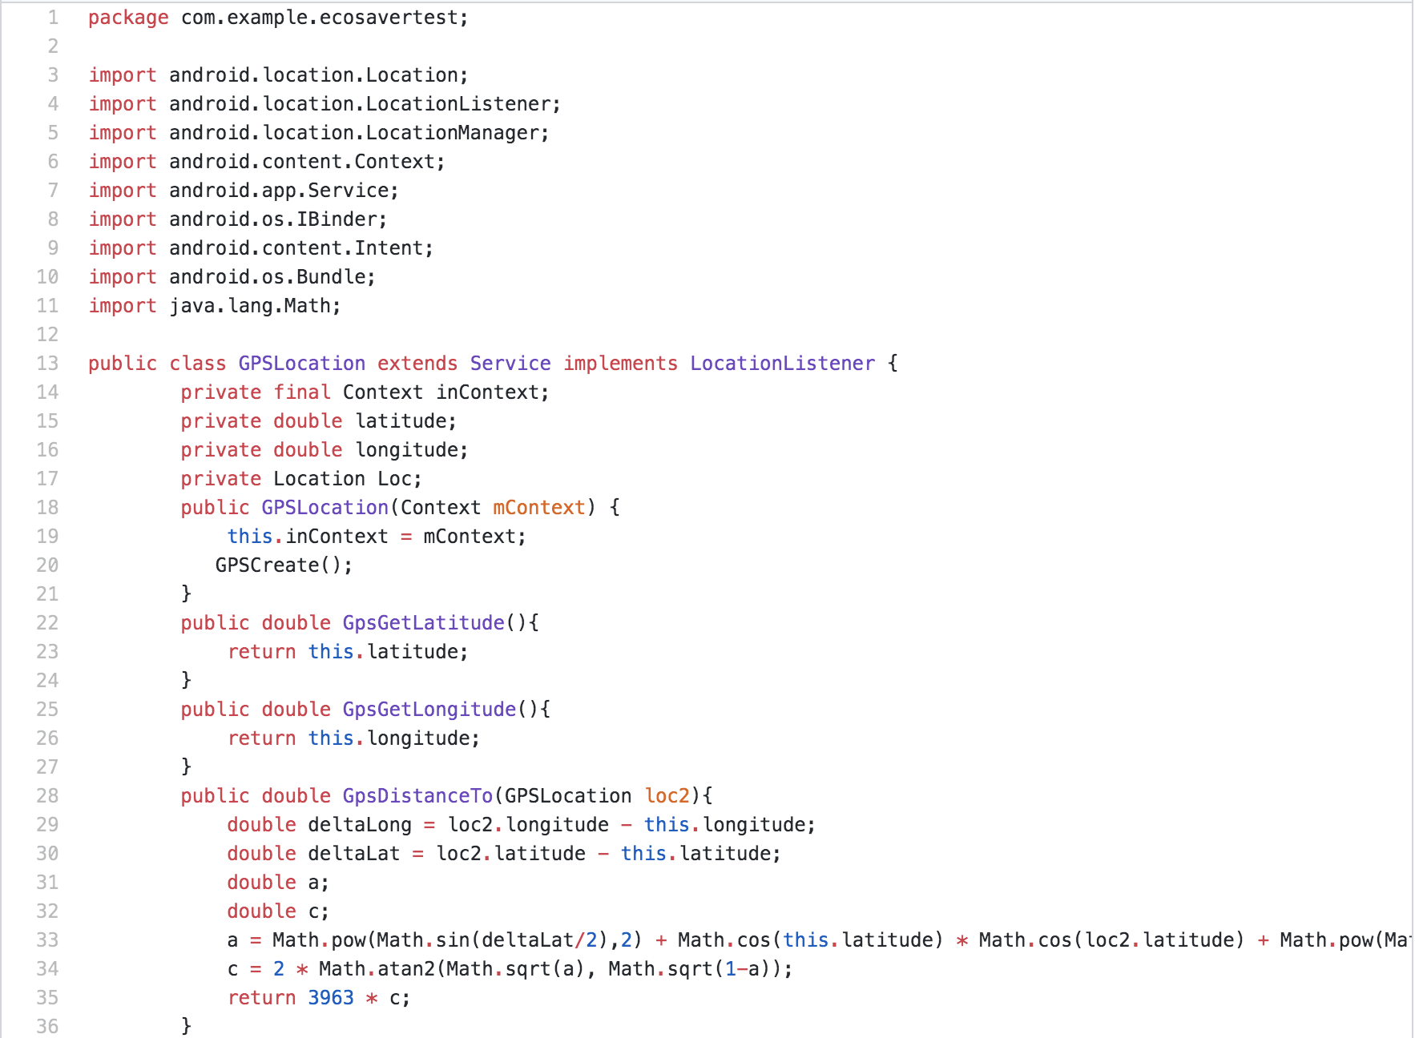
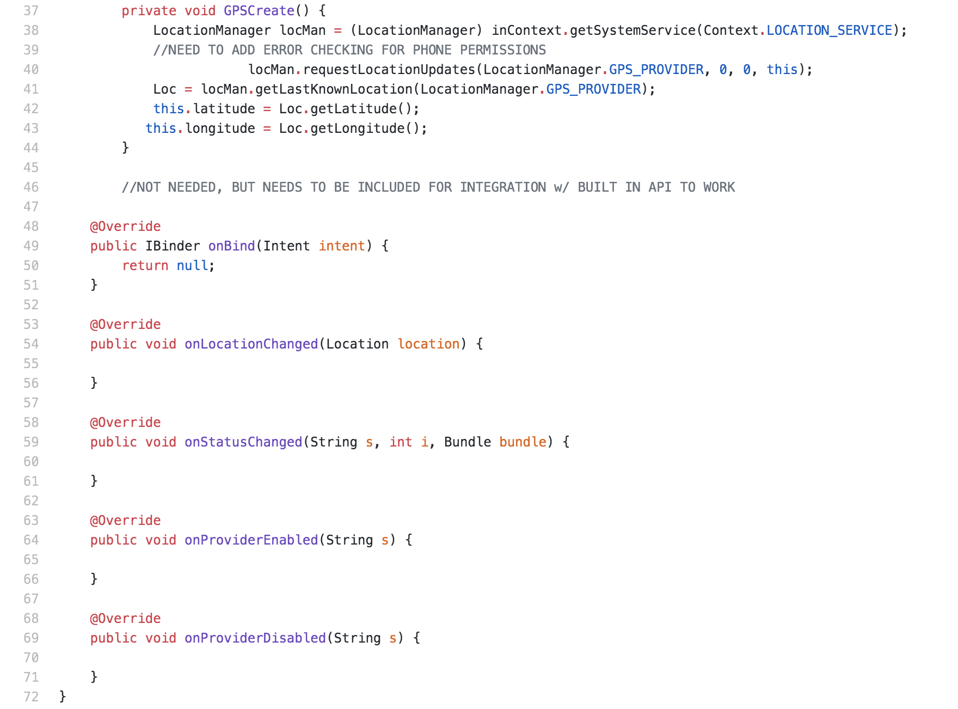
GPS
This function uses two key coordinates, latitude and longitude, to know where the exact position the user is. Distance tracker applications and location tracker apps are what the goal is for GPS function.

Slide 12
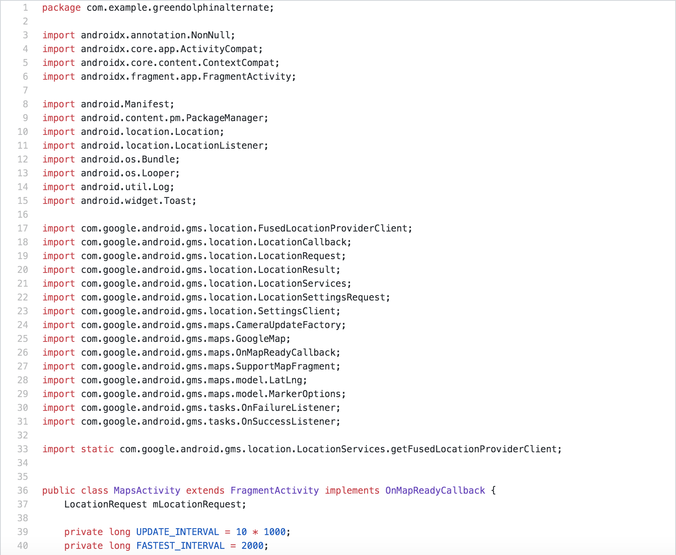
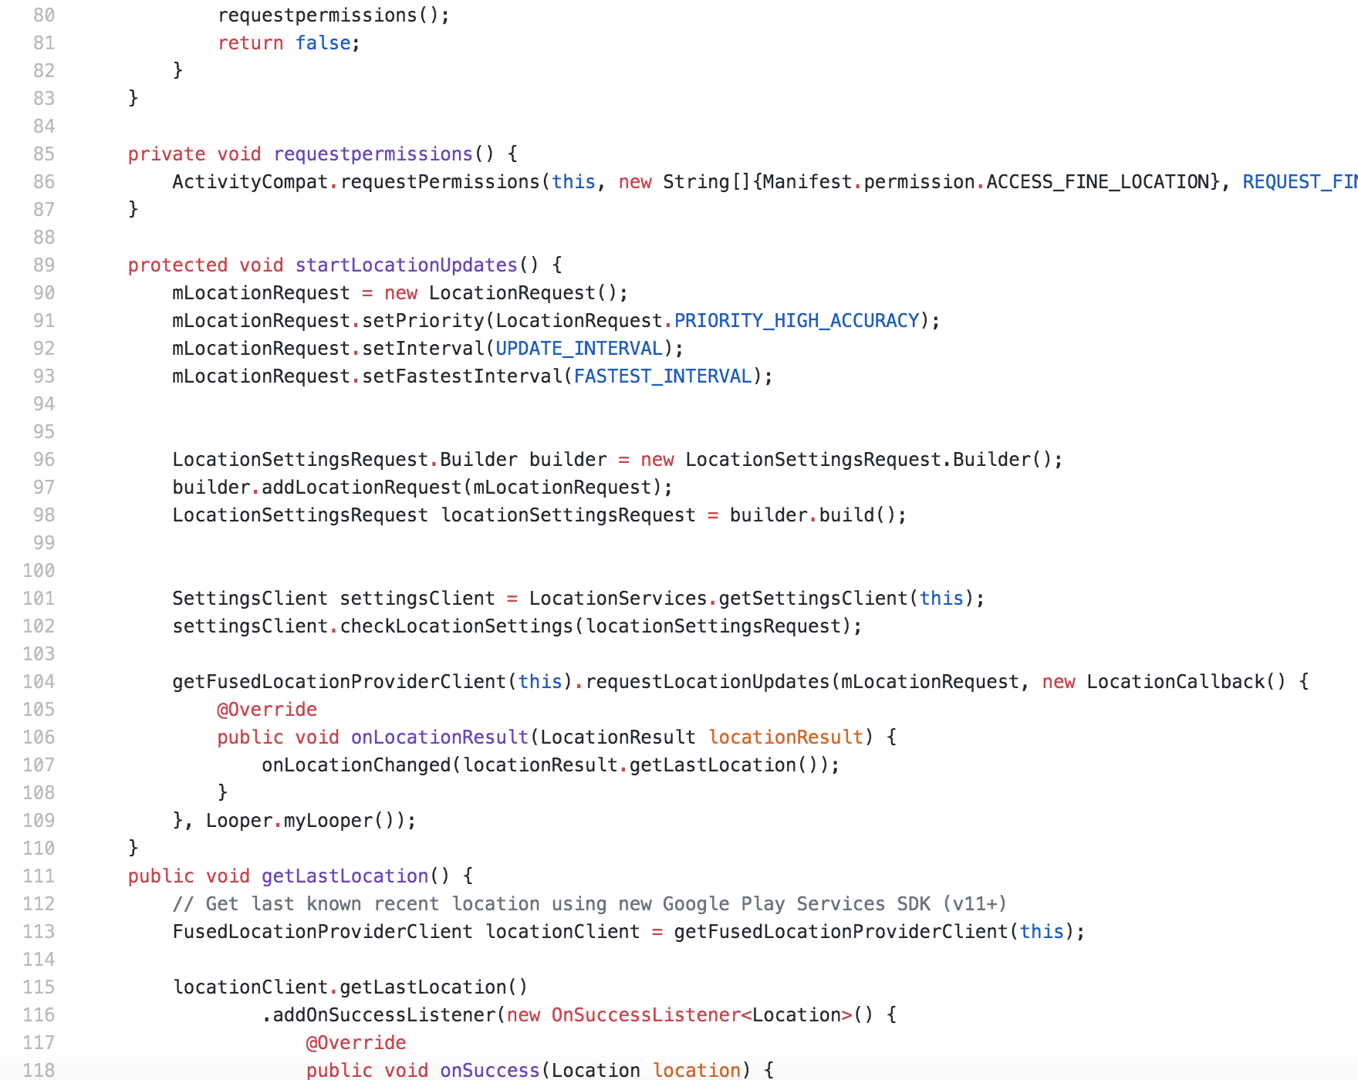
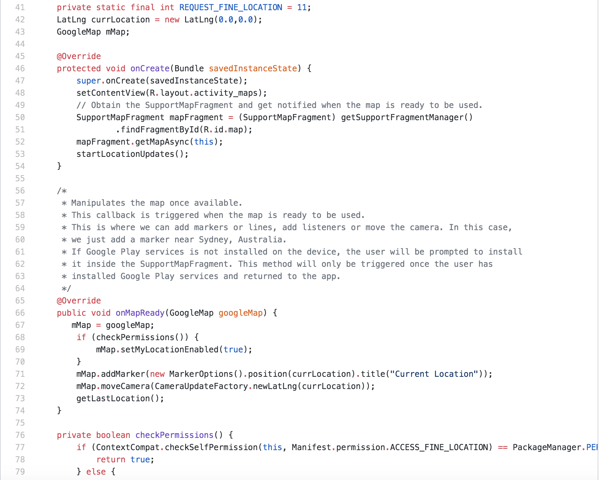
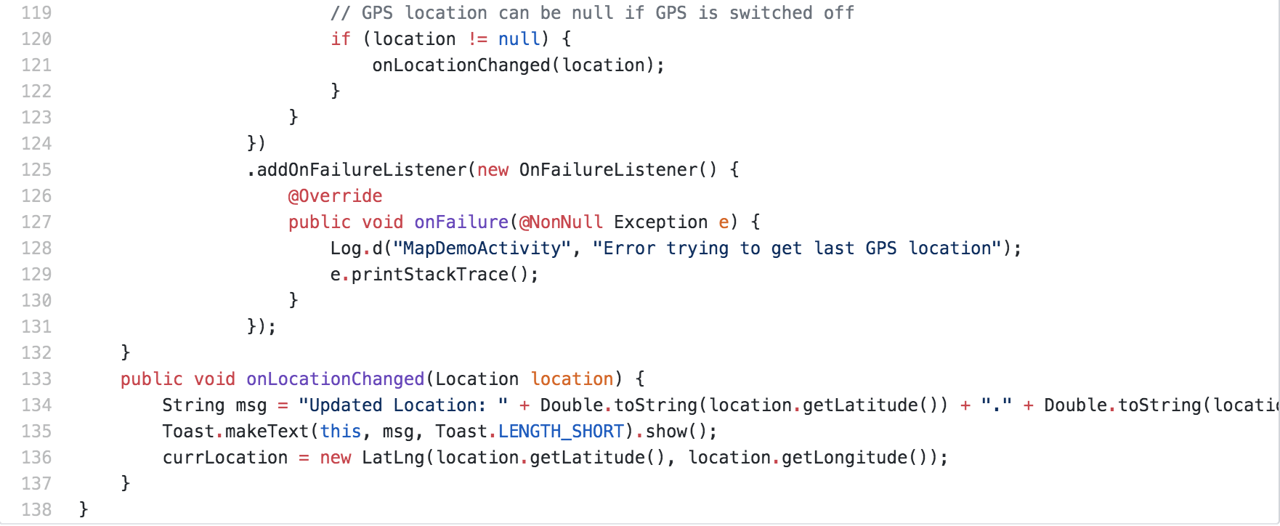
Maps Activity
This function manipulates the map once, allowing us to add markers, lines, listeners. It provides us the tool of the routine that the user walked.

Slide 13
Point System
This function pinpoint the recycling stations near the user’s location, showing the points on the map for user to know where exactly he or she can go to do the recycle.

Slide 14
Recycle Rules
This function calculates the items that the user recycled by asking for inputs, and convert those items with points.

Slide 15
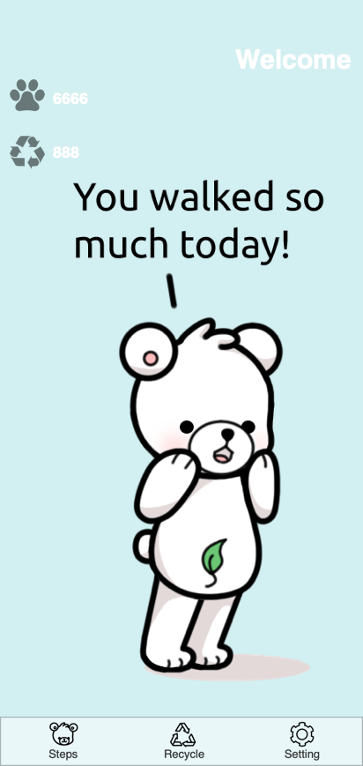
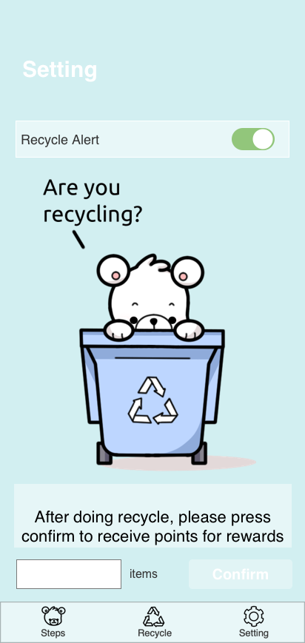
UI Design
UI design is the interface that the user directly will see. All the buttons, scrolls, and flips are all designed from Android Studio. Furthermore, the change of different images in different situations is also implemented.

Slide 16
Reference Sites
https://www.tukuppt.com/soback/huanbao.html
http://www.51pptmoban.com/pic/695.html
http://www.51pptmoban.com/pic/450.html
https://www.ntaskmanager.com/blog/5-insane-project-management-techniques-in-todays-market/
https://bauschrewards.com/spendactivities
https://www.123rf.com/photo_81035061_stock-vector-fitness-tracking-app-on-mobile-phone-screen-vector-illustration-flat-cartoon-style-smartphone-with-r.html
https://www.123rf.com/photo_35483452_creative-abstract-gps-satellite-navigation-travel-tourism-and-location-route-planning-business-conce.html
https://www.iconfinder.com/icons/2526356/accelerometer_auto_rotate_mobile_rotate_rotation_screen_smartphone_icon
https://www.elegantthemes.com/blog/wordpress/calculated-fields-form-plugin-overview-and-review
https://us.clipdealer.com/vector/media/A:106834752
https://iconscout.com/icon/gps-1524935
https://www.iconfinder.com/icons/2262525/arrows_bin_eco_ecology_recyclable_recycling_icon
https://www.iconfinder.com/icons/2352275/design_interface_mobile_ui_ux_icon
http://www.51yuansu.com/bg/cqqemkelcd.html

Slide 17
Thank You

